Slide 1
Concepts that should be covered in TCL PPT
Why TCL? importance of TCL
Set ,puts command, [], {} braches difference
3. Arithmetic, logical and boolean operations
4. All conditional loops
5. Arrays
5. Strings
6. Lists
7. File handing
8. Regular expressions, regexp and regsub

Slide 2
Why TCL? importance of TCL
TCL stands for Tool Command Language, and it is a scripting language that is easy to learn and has a clear and concise syntax. It provides developers with a simple and efficient way to automate tasks and write scripts.
TCL has a rich set of built-in libraries and extension frameworks, making it highly extensible. Developers can easily add new functionalities and customize TCL to suit their specific needs.
TCL is platform-independent, which means that scripts written in TCL can run on different operating systems without any modification. This portability is crucial for cross-platform development and reduces the effort required to maintain and support applications on multiple platforms.

Slide 3
Set ,puts command, [], {} braches difference
set varName ?value?: If value is specified, then the contents of the variable varName are set equal to value .
If varName consists only of alphanumeric characters, and no parentheses, it is a scalar variable.If varName has the form varName(index) , it is a member of an associative array.
Ex: set a 5 # variable is declared and assigned value 5

Slide 4
Set ,puts command, [], {} braches difference
puts ?($variable)/ ? “string “: this command prints the variable vlaues or prints the string
Ex: puts “hey”// prints hey
puts $a //prints value variable a
$ sign in used as prefix with variable to print value in command line.
[ ]:- this is used for assinging values to variables from other expressions and also to execute commands and give output.
{ }:- this is used in puts for printing the command as it is ignoring the commands and special pointers
Semi colo (;) :- is useful when writing two commands in a single line.

Slide 5
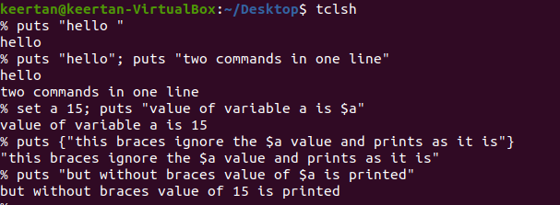
Examples of all the points mentioned above

Slide 6


Slide 7
Arithmetic, logical and boolean operations
Arithmetic operators : are + , -, *, / , % .These are used along with the command “expr” (expression)
Arithematic operations :
1.Expr Statement : “expr” is used to evaluate the exppression
Syntax :expr var1 operator var2
ex: set c [expr 4 + 5];//set c value as 9
set a[expr 3 + $c];// sets a value as 12

Slide 8
Logical Operators (A=0,B=1)
Logical Operators:
1.Logical AND operator (&&):
2.Logical OR operator (||): (A || B)->true.
3.Logical NOT operator (!): !(A &&)-> true.
Example :- (A&&B)-> false
(A || B ) -> true
!(A && B ) -> true

Slide 9
Bitwise operators
These operators operator on bits and executes bit-by-bit operations.
1. & =Bitwise AND
2. | =Bitwise OR
3. ^ =Bitwise XOR
4.<< =Bitwise leftshift operator
5.>>= Bitwise rightshift operator

Slide 10
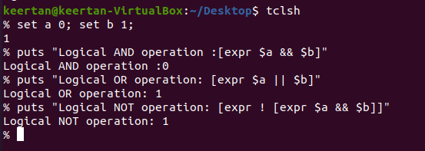
Examples of operators

Slide 11
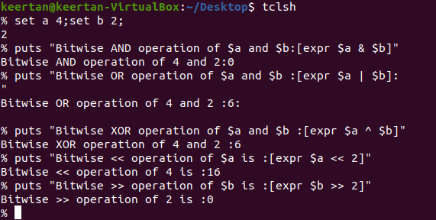
Examples

Slide 12
Conditional Statements
IF condition: it executes a block of block only if the the condition is met or ski the block of code from execution.
Syntax: if {condition } { //code} else { //alternative code }
While loop :it keeps executing a block of code repeatedly till the condition mentioned becomes false.
Syantax : while {condition} { //code }

Slide 13
For loop : it executes the same block repeatedly till condition mentioned becomes false.
Syntax : for {initialization} {condition } { progression} { //code }
Foreach loop: it used to iteratte through arrays and lists usually.
Syntax: foreach {variable} {list} {//code }

Slide 14
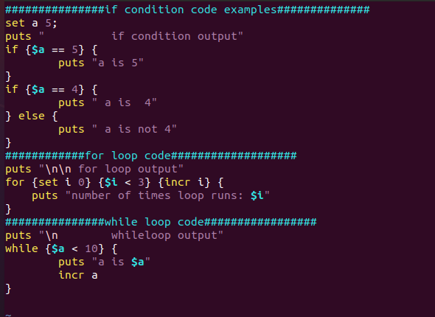
Example code

Slide 15
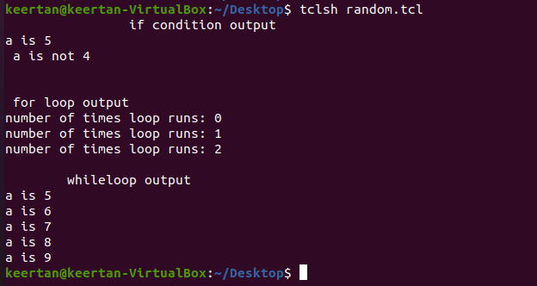
Outputs of examples

Slide 16
Arrays
Arrays are group of elements of same data type.
Syntax :
set array_name { index } {element1}
set array_name { index2 } {element2}
Associative Array: are unordered set of values
Which can be accessed with corresponding keys.
They have an index that is not necessarily a number , and can be sparsely populated.
Syntax:- set array_name {keys } value

Slide 17
Strings
The string Command The string command is a collection of many operations you can perform on strings and its manipulations.
Some of the examples are :
Length of the value of a variable:
Syntax: [string length $variable/string]
Example: set tr “keertan“
puts [ string length $tr]
Output =7
2. Compares strings : this comapres two string and returns 1 is str1 >str2 else 0
example: set a “hi”;set b “hey”
puts [string comapre $a $b]
Syntax : [string compare str1 str2]

Slide 18
[string range $varstr index1 index2]: Return the range of characters in string from index1 to index2.
example : puts [string range “hey this is it” 0 2] // returns string from index 0 to 2 (hey)
[string tolower $varstr]: Returns the lowercase string.
example :puts [string tolower “KEERTAN”]//returns keertan
[string toupper $varstr]: Returns the uppercase string.
Example :puts [string toupper “keertan”]//returns KEERTAN

Slide 19
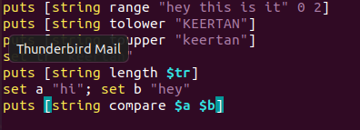
Examples

Slide 20
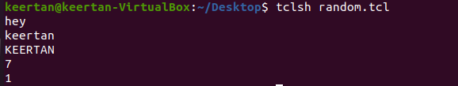
Output

Slide 21
Lists
List is a ordered collection of items.Items can be of same data type or different type.
Creating a List:
Syntax: set listName { item1 item2 item3 .. Item i}
Appending Item to a List:
Syntax :lappend listName $var_value

Slide 22
Length of List: The syntax for length of list is given below:-[llength listName]
List Item at Index : The syntax for selecting list item at specific index is given below −
[lindex listname index]
Replace Items at Indices: The syntax for replacing list items at specific indices is given below −
[lreplace listname firstindex lastindex value1 value2..valuen]
Set Item at Index: The syntax for setting list item at specific index is given below −
[lset listname index value]

Slide 23
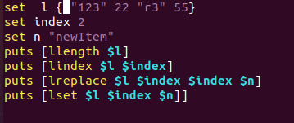
Example Code

Slide 24

output

Slide 25
Procedure
Procedure is similar to function c Programming
Syntax :proc name {arguments} { body }
Example:
proc print {name} { puts "$name" }
print “keertan”

Slide 26
File Handling
Tcl supports file handling with the help of the built in commands open, read, puts, gets, and close.A file represents a sequence of bytes, does not matter if it is a text file or binary file.
Opening Files:-Tcl uses the open command to open files in Tcl.
The syntax :− [open fileName accessMode ]

Slide 27
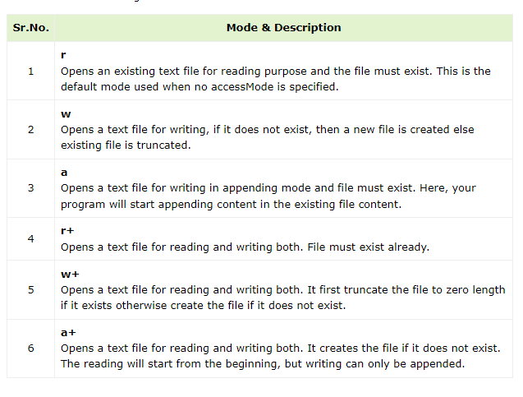

Slide 28
Closing a File:To close a file, use the close command. The syntax :- close $filename
Writing a File:Puts command is used to write to an open file.
Syntax:- puts $filename "text to write“
Reading a File: Following is the simple command to read from a file −
Syntacx :- set file_data [read $fp]

Slide 29
Regular expressions
Regular expressions are patterns used for matching and manipulating text.
The "regexp" command is used to match a regular expression in Tcl.
Syntax:
[regexp pattern string/$varName ]
Example:
Puts [regexp {^[A-Za-z]+$} $input]

Slide 30
Reg sub
regsub is used for string substitution based on regular expressions.
Syntax: [regsub –nocase –all “match_string” “data” “replace_string” new_data]
Example:[regsub –nocase -all {(\d+)} $input $modifiedInput]
Flags: Optional flags to modify the behavior of the substitution.
Expression (exp): Regular expression pattern to match in the input string.
String (string): The input string on which the substitution is performed.
Substitution Specification (subSpec):
Specifies the replacement string or pattern.
Variable (varName):
Variable to store the modified string.

